Slide 1
Notes:
Are these rocks the same? Why? Get students to describe what is different about them –colours, do they have holes, are they banded, are they smooth or rough?

Slide 2
What is a rock exactly?
Notes:
Make a table on the board with title "Rocks / Not Rocks" and classify the following examples

Slide 3
Make two columns in your notebook, headed rocks… and …not rocks.
For each of the substances on the following slides, write their name in one of the column.
ROCKS | NOT ROCKS

Slide 12
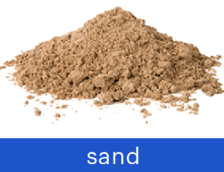

Slide 14
Rocks are
1. Solids
2. Made naturally within the Earth (not man-made)
3. Made up of minerals and possibly organic material
4.Vary In composition and appearance

